Slide 1

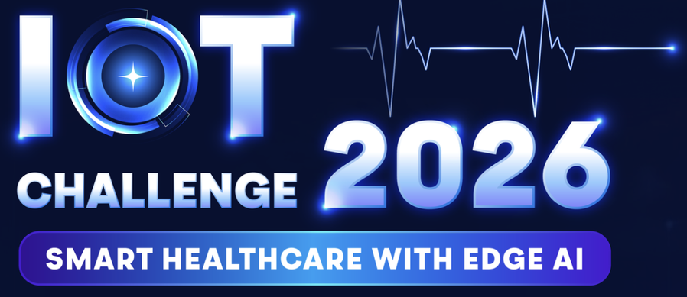
Smart IV & Patient Safety Monitoring System
Team ICTU
August , 2026
1
Notes:
1

Slide 2


Table of content
Content
1.Introduction
2.The Problem
3.Solution Overview
4.System Architecture
5.AI&TinyML
6. User Flow
7.Demo
2
Notes:
2

Slide 3

Introduction
Team Name:ICTU
Team Size: 5
Team Lead Name:Lai Van Thinh
Team Members (5)
Name:Lai Van Thinh
University:Thai Nguyen University of Information and Communication Technology
Course and Year Group:Software Engineering(Second Year)
Contact Email:thinh1092006@gmail.com
Discord Handle:vthihn
Name:Pham Van Huynh
University:Thai Nguyen University of Information and Communication Technology
Course and Year Group:Computer Engineering (third year)
Contact Email:huynhpham13790@gmail.com
Discord Handle:huynhca0159_81062
Name:Dam Duc Don
University:Thai Nguyen University of Information and Communication Technology
Course and Year Group:Computer Engineering (third year)
Contact Email:don123edm@gmail.com
Discord Handle:d_0nt
Name:Dinh Van Hieu
University:Thai Nguyen University of Information and Communication Technology
Course and Year Group:Electronics and Telecommunications Engineering (Year 5)
Contact Email:dinhhieu1st@gmail.com
Discord Handle:hieu1804
Name:Ly Khanh Quan
University:Thai Nguyen University of Information and Communication Technology
Course and Year Group:Computer Engineering (final year)
Contact Email: khanhquan2k@gmail.com
Discord Handle:
3
Notes:
3

Slide 4
The Problem
THE PROBLEM
5
Notes:
4

Slide 5
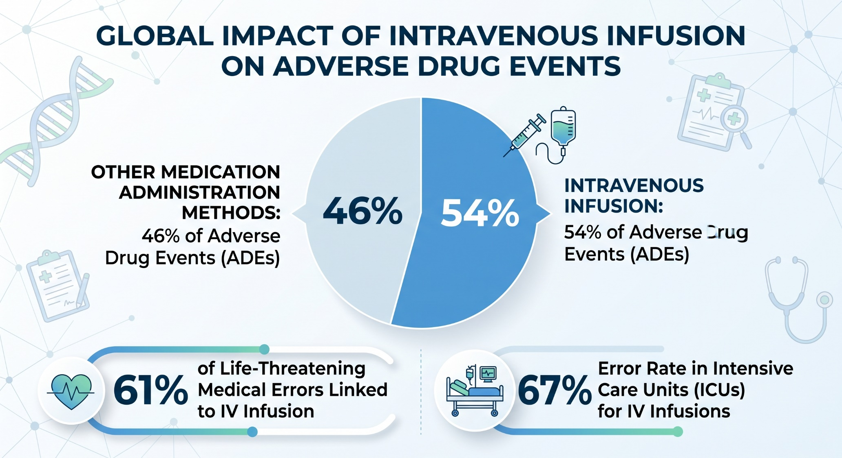
The Problem
2.1.The hidden reality of IV Therapy
5
Notes:
4

Slide 6
The Problem
2.2.Three Core Problems
Unstable Gravity-Based Flow
Limitations of manual monitoring (Lack of continuity)
Warning threshold (Lacks personalization)
Gravity-fed systems are inherently vulnerable to environmental factors (temperature, viscosity) and patient movement, directly compromising infusion accuracy.
Nurses cannot be omnipresent; it is impossible to manually monitor drop rates at every bedside, every second. This limitation leads to critical delays in identifying risks.
Current alerts are one-size-fits-all. The same flow error may be harmless for a healthy adult, but critical for vulnerable patients (e.g., heart failure, pediatrics).
5
Notes:
4

Slide 7
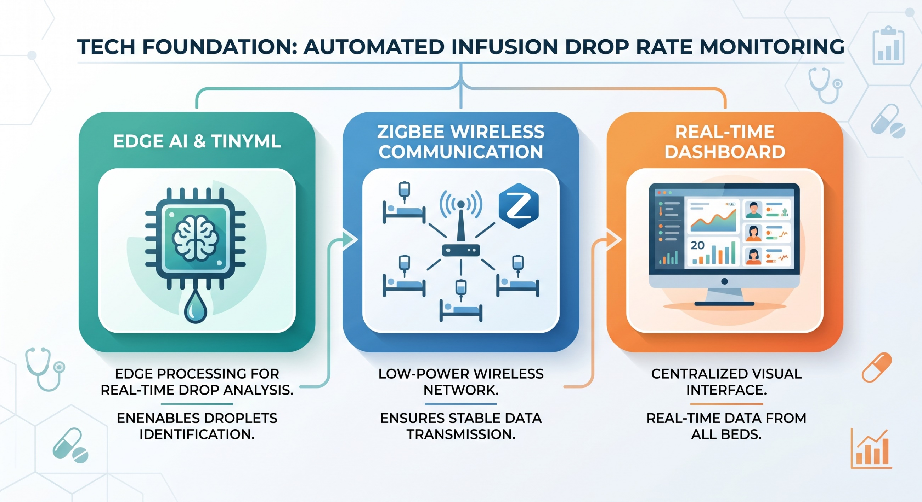
Solution Overview
3.Solution Overview
Our team proposes the Smart IV & Patient Safety Monitoring System
6
Notes:
6

Slide 8
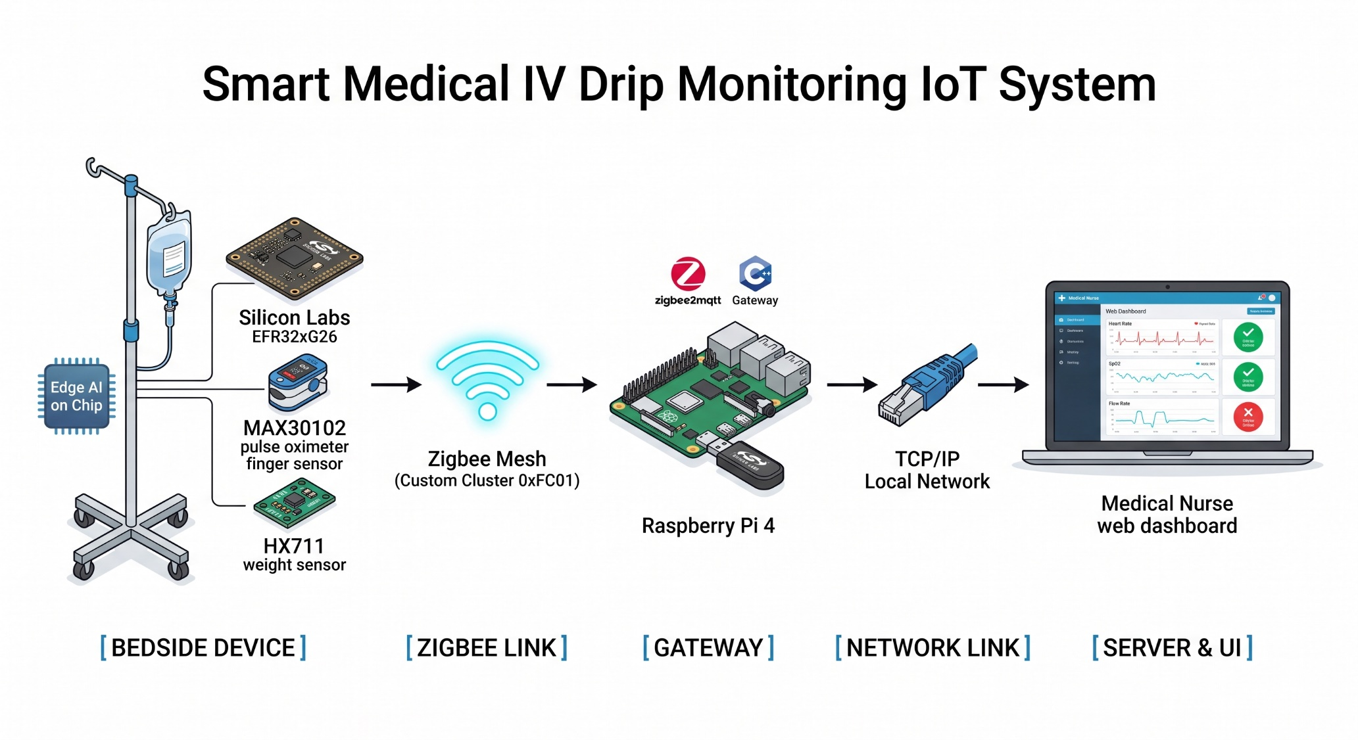
System Architecture
5.System Architecture&Data Flow
9
Notes:
12

Slide 9
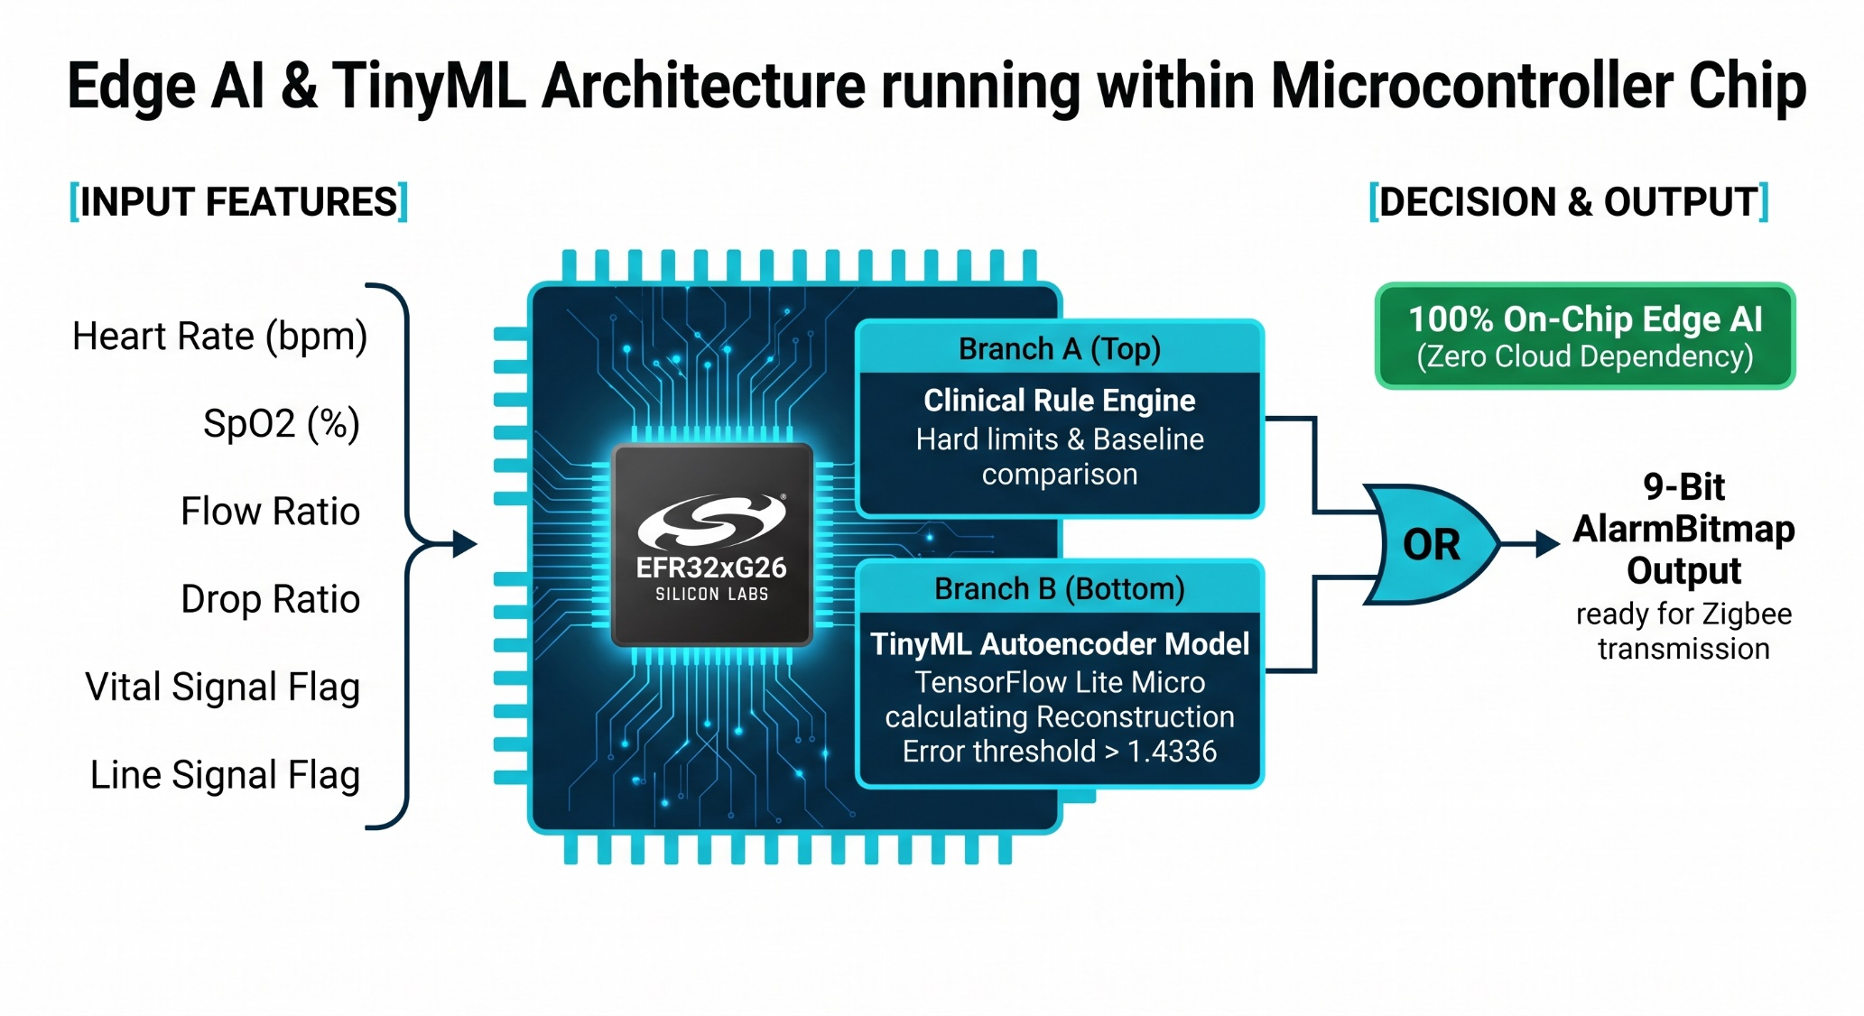
AI&TinyML
6.AI&TinyML
9
Notes:
12

Slide 10
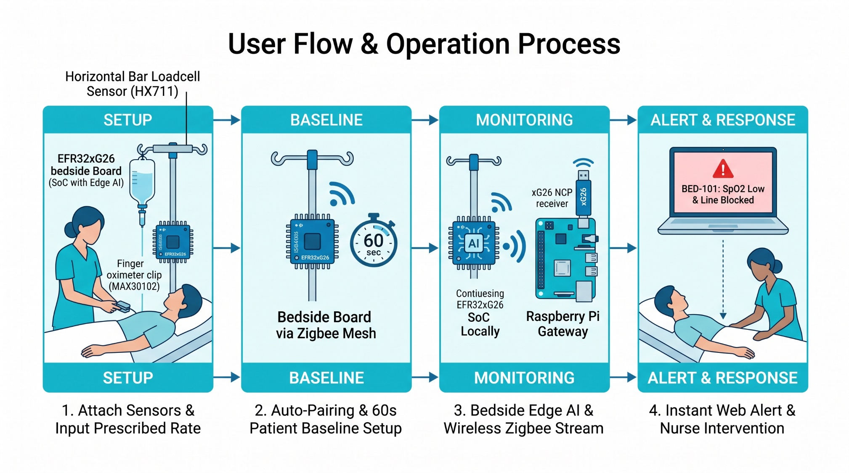
User Flow
7.User Flow
9
Notes:
12

Slide 11
Demo & Milestones
8.1.Demo
Thuyết minh về sản phầm hoạt động thực tế
9
Notes:
12

Slide 12

17
Notes:
19

